Slide 1
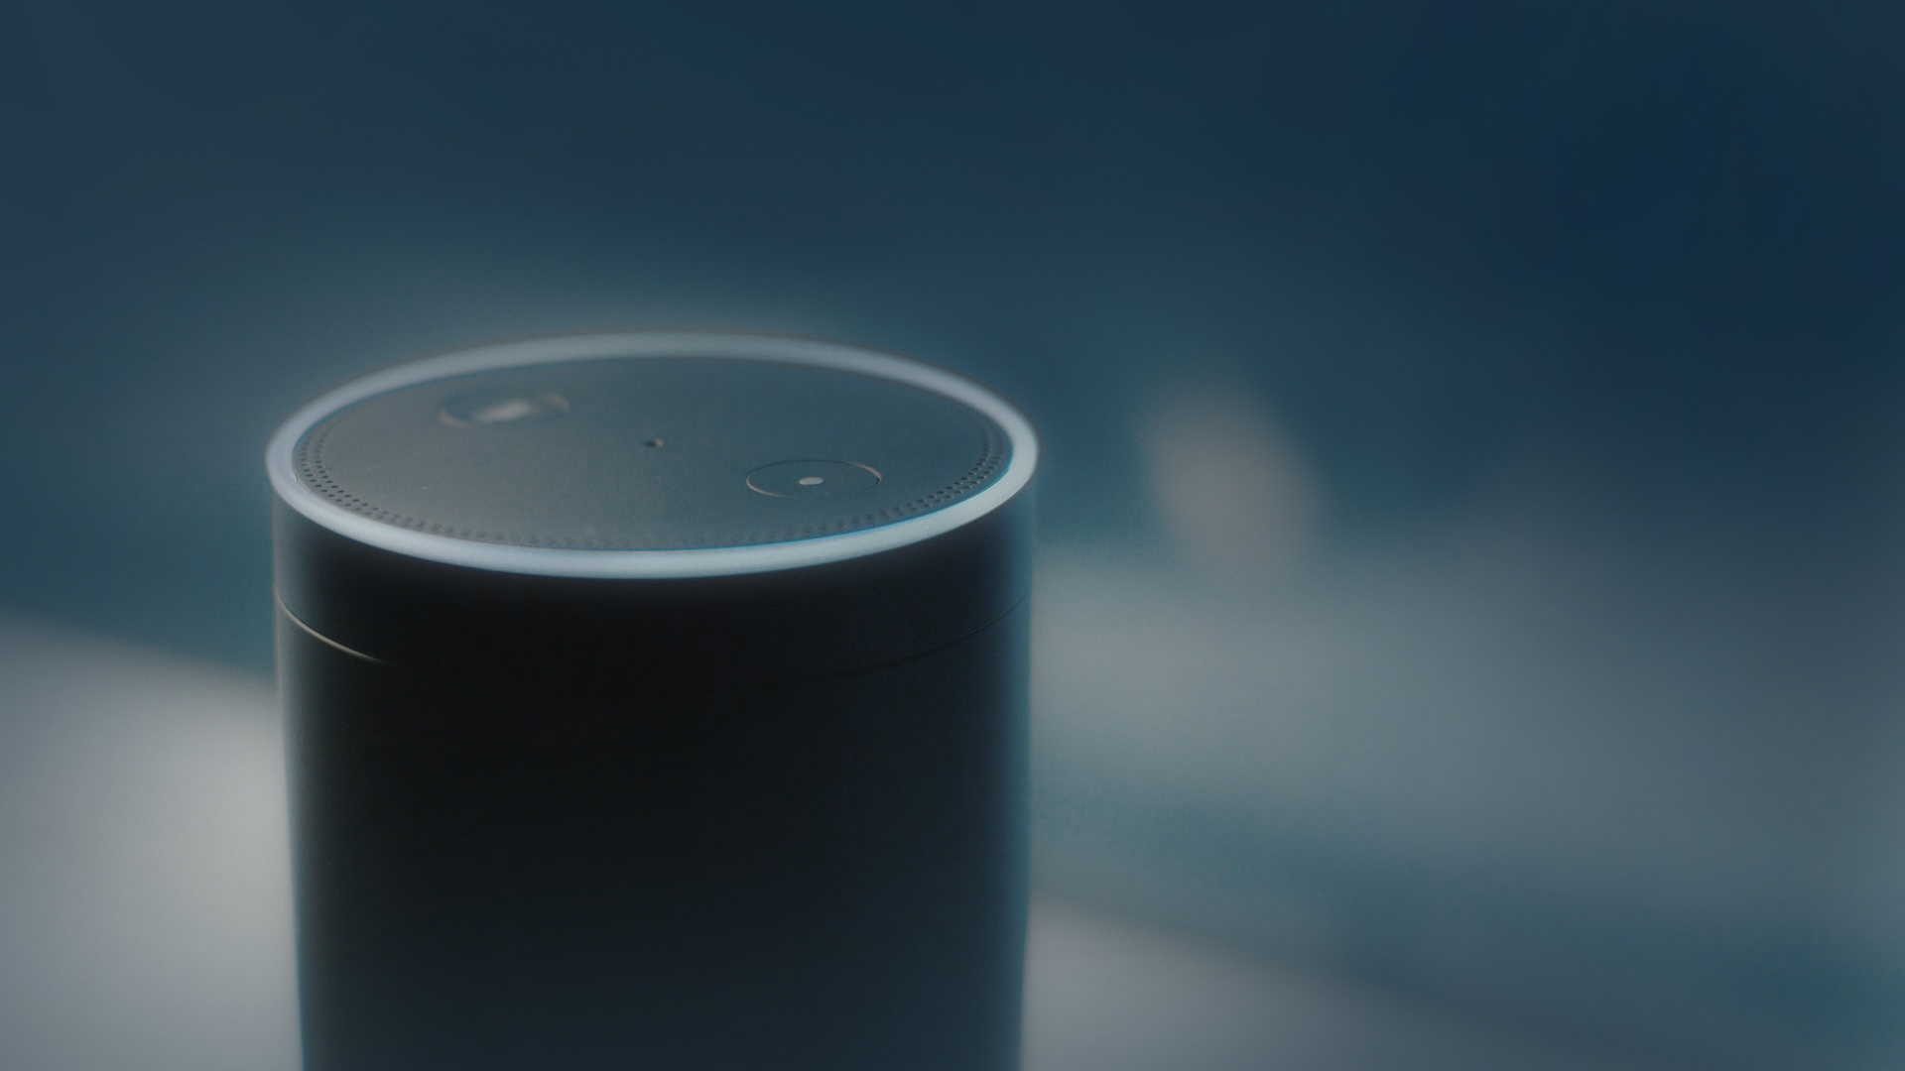

Welcome to Med Assist
Hello
voice assistant

Slide 2
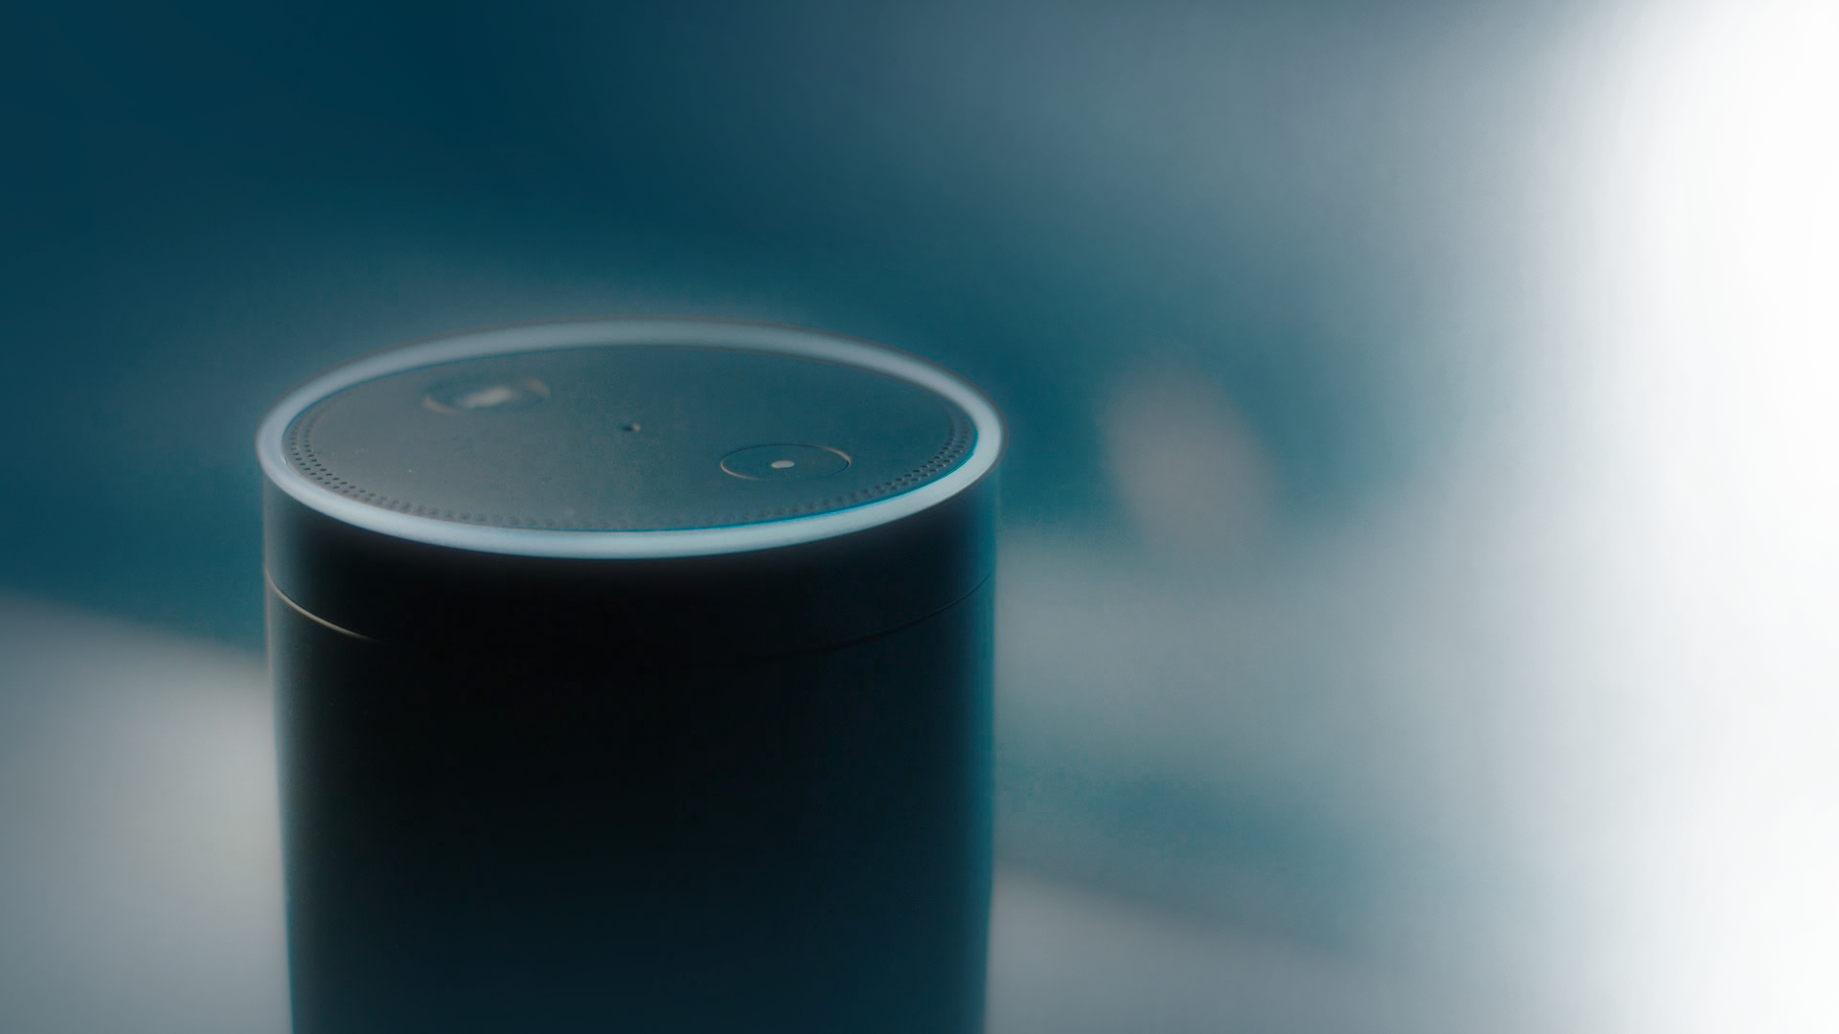
Ok, I will tell your appointments.
What's on today
Could you please tell your identification number?

Slide 3
Hello Guest, Doctor appointment done via Alexa for ear specialist at Kochi, Kerala, India on Friday July 21st, 2017
One thousand

Slide 4
tell me about appointments one
Here's the description, your appointment for ear specialist is booked on 21st of July at timing from: 4:00 PM to 4:30 PM.
Would you like to hear another event?

Slide 5
No
Thank You

Slide 6
Thank you

